Slide 1
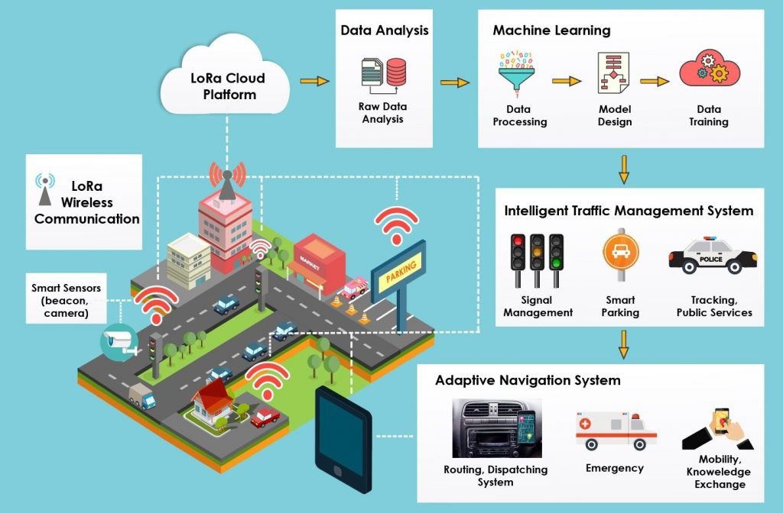
Smart Traffic Control System
P.HYNDAVI(192211891)
A.MAHESWARI(192211991)

Slide 2

Smart Traffic Control System
This presentation delves into the design and implementation of a smart traffic control system using the C++ programming language. The system utilizes real-time data analysis and intelligent algorithms to optimize traffic flow, reduce congestion, and enhance road safety.

Slide 3
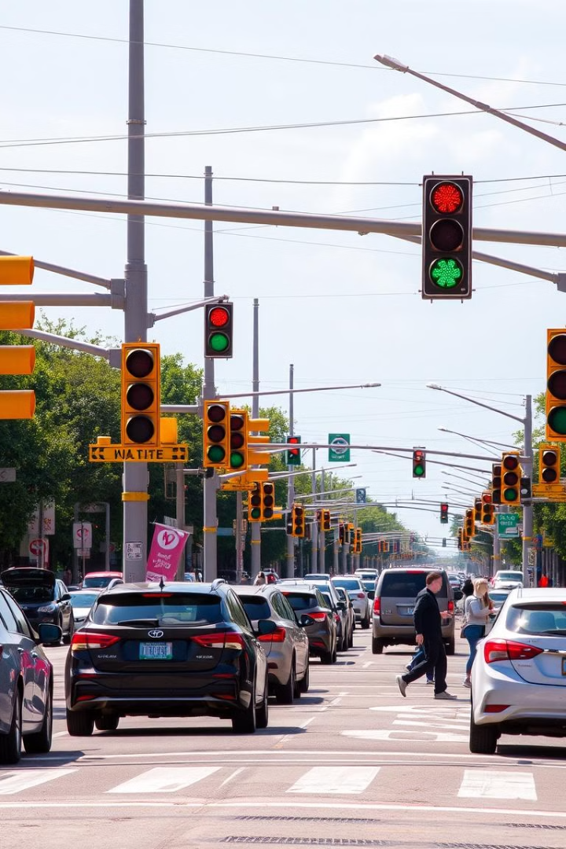
Introduction to Smart Traffic Control
1
Traffic Management Evolution
2
Real-Time Optimization
Traditional traffic control systems rely on fixed signal timing, often leading to inefficient traffic flow and increased congestion.
Smart traffic control systems utilize real-time data and intelligent algorithms to dynamically adjust signal timing, reducing delays and optimizing flow.
3
Data-Driven Decisions
Sensors gather data on traffic volume, speed, and other factors, enabling the system to adapt to changing conditions.

Slide 4

Objectives of the System
Reduce Congestion
Enhance Road Safety
Minimize traffic delays by optimizing signal timing and flow, reducing fuel consumption and improving overall efficiency.
Improve pedestrian and driver safety by identifying potential hazards and adjusting signal timing to prevent accidents.
Promote Sustainability
Reduce emissions and fuel consumption by optimizing traffic flow, contributing to a cleaner and more sustainable environment.

Slide 5
Key Components of the System
Traffic Sensors
Communication Network
Traffic Signal Control Unit
Sensors gather real-time data on traffic volume, speed, and other factors. Examples include loop detectors, radar sensors, and video cameras.
The network connects all components of the system, enabling data exchange and real-time communication between sensors, control units, and other devices.
The control unit receives data from sensors, analyzes the information, and adjusts traffic signal timing to optimize flow.

Slide 6

Traffic Sensor Integration
1
Sensor Selection
Choose the appropriate sensor types based on the specific needs of the intersection, such as loop detectors, radar sensors, or video cameras.
2
Sensor Calibration
Calibrate sensors to accurately measure traffic volume, speed, and other parameters to ensure reliable data collection.
3
Data Acquisition
Integrate sensors with the communication network to transmit real-time data to the control unit for processing and analysis.

Slide 7
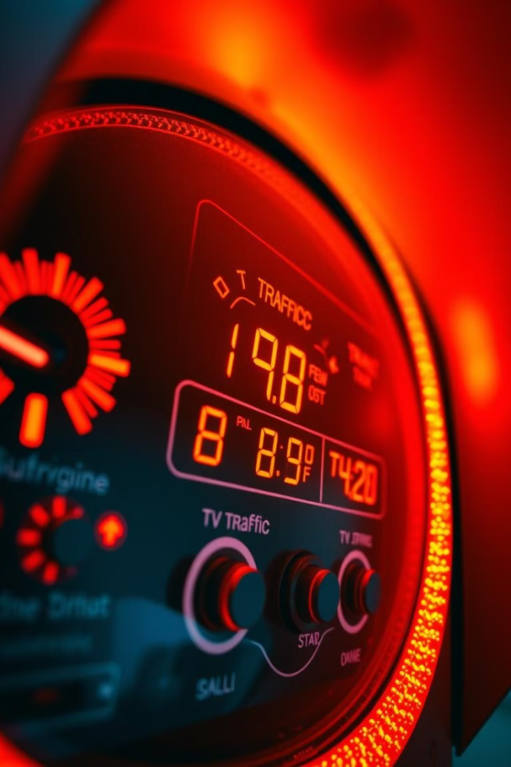



Traffic Signal Optimization Algorithms
Traffic Flow Analysis
Algorithms analyze real-time traffic data to identify congestion patterns, bottlenecks, and other critical factors.
Signal Timing Adjustment
Based on the analysis, algorithms dynamically adjust signal timing to optimize traffic flow, reduce delays, and enhance safety.
Adaptive Control
The system continuously monitors traffic conditions and adjusts signal timing in real time, ensuring efficient flow and minimal delays.

Slide 8

Adaptive Traffic Light Timing
Traffic Volume
Signal Timing
High Traffic
Shorter Green Phase for Less Congested Roads
Low Traffic
Longer Green Phase for Roads with Higher Traffic

Slide 9
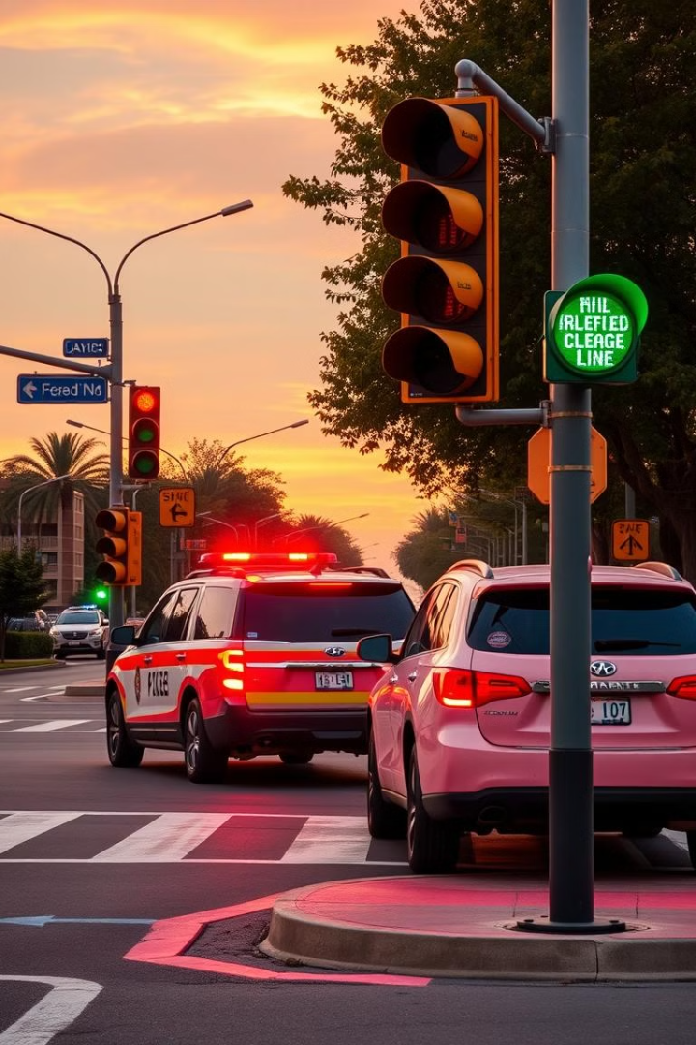



Vehicle Priority Management
Emergency Vehicles
Prioritize emergency vehicles by automatically switching traffic signals to green, allowing them to pass through intersections quickly and safely.
Public Transportation
Optimize traffic flow for public transportation vehicles, such as buses, to encourage efficient and reliable public transit use.
High Occupancy Vehicles
Provide incentives for carpooling by granting priority to vehicles with multiple occupants, promoting sustainable transportation practices.

Slide 10
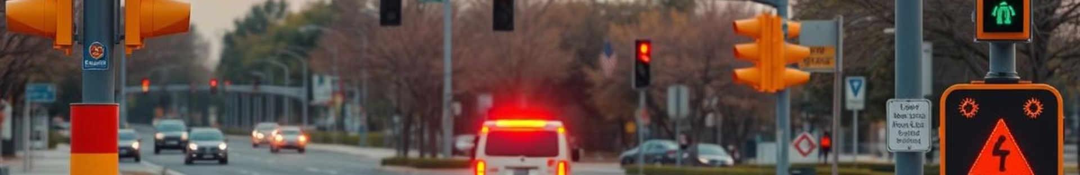
Emergency Vehicle Detection and Response
1
Vehicle Detection
Utilize cameras and sensors to identify emergency vehicles, such as ambulances, fire trucks, and police cars, based on their distinctive features.
2
Signal Preemption
Upon detection, the system automatically switches the traffic signals to green for the emergency vehicle's lane, providing a clear path through the intersection.
3
Warning Messages
Display warning messages on nearby traffic information signs to alert drivers to the approaching emergency vehicle, promoting safe driving practices.

Slide 11

Conclusion and Future Enhancements
Smart traffic control systems offer a significant advancement in traffic management. The C++ implementation discussed in this presentation demonstrates the potential to optimize traffic flow, reduce congestion, and enhance road safety. Future advancements in data analytics, artificial intelligence, and vehicle communication technologies can further improve the system's capabilities and enhance the overall urban transportation experience.

Slide 12


